Slide 1
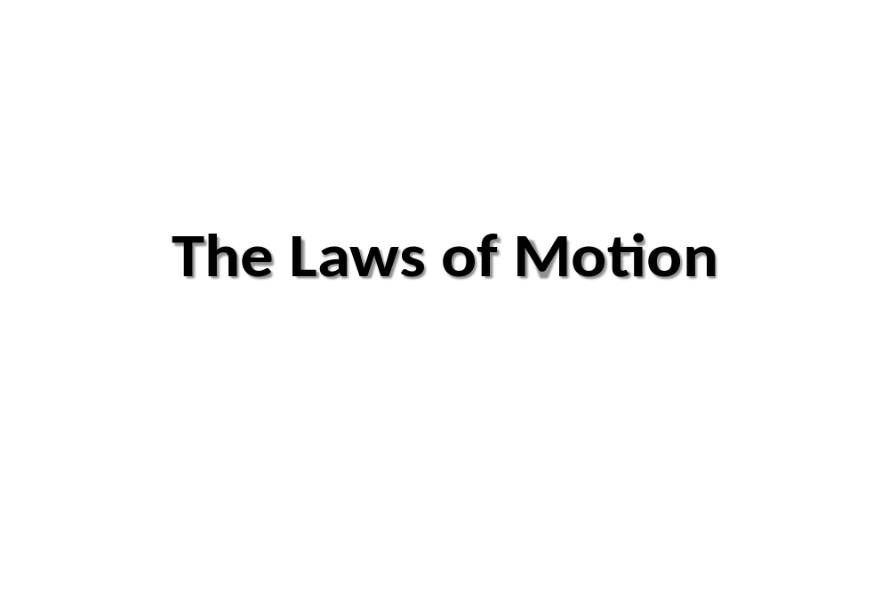
Motion in One Dimension

Slide 2
Kinematics
Describes motion while ignoring the external agents that might have caused or modified the motion
For now, will consider motion in one dimension
  Along a straight line
  i.e. Rectilinear Motion
Motion represents a continual change in an object’s position.

Slide 3
Types of Motion
Translational/Rectilinear
  An example is a car traveling on a highway.
Rotational
  An example is the Earth’s spin on its axis.
Vibrational
  An example is the back-and-forth movement of a pendulum.

Slide 4
Introduction
What do we mean by motion in one dimension?
An object A is in “motion” means that its position with respect to another object B changes with time.
E.g. Houses and trees are in motion with respect to
the Sun but are not in motion with respect to each
other
Motion in one dimension means that we restrict the object to travel along one axis only
Examples:
(i) A car moving along a flat, straight, narrow road
(ii) A leaf falling straight down from a tree
Here motion is confined to a straight line

Slide 5
Introduction, cont.
For such restricted motion, there are only two possible directions (positive & negative), up/ down, left/ right

Slide 6
Objective of Lecture
Learn about the relationship between distance/ displacement, velocity and acceleration

Slide 7
Particle Model
To describe motion of an object in one dimension, treat the object as a particle.
  A particle is a point-like object; has mass but infinitesimal size
- This course will adopt the particle model
This means that the variations in its rotational motion or its internal structure do not occur or are not of concern

Slide 8
Definitions
To define our quantities, we first set up a coordinate, which in this case (is one dimensional) is a straight line with a reference point O on it.
To every point on the line assign a number x (in cm, n, miles…) that measures the distance Ox
The sign of x depends on its position relative to O
  Usually, points to the right of O are positive
  Points to the left of O are negative
  Suppose at time t₁, a particle is at x₁ (i.e. position x₁ )
  and at time t₂, the particle is at position x₂

Slide 9
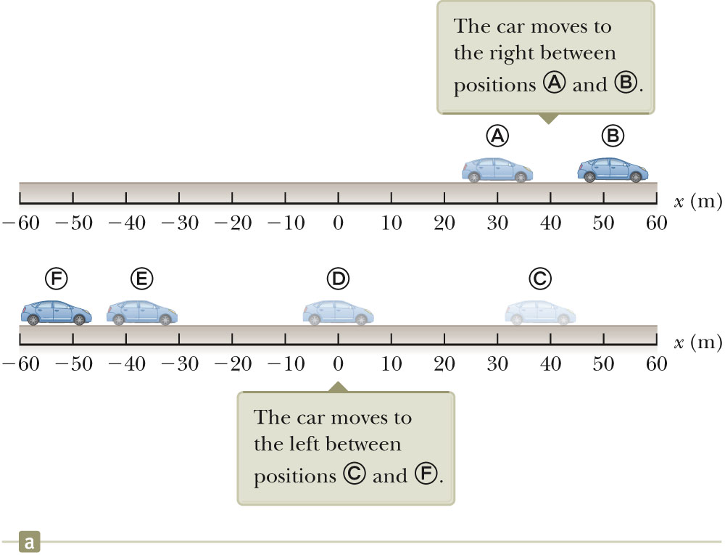
Position: Example
The object’s position is its location with respect to a chosen reference point (0).
  Consider the point (0)to be the origin of a coordinate system.
We are only interested in the car’s translational motion, so model it as a particle

Slide 10
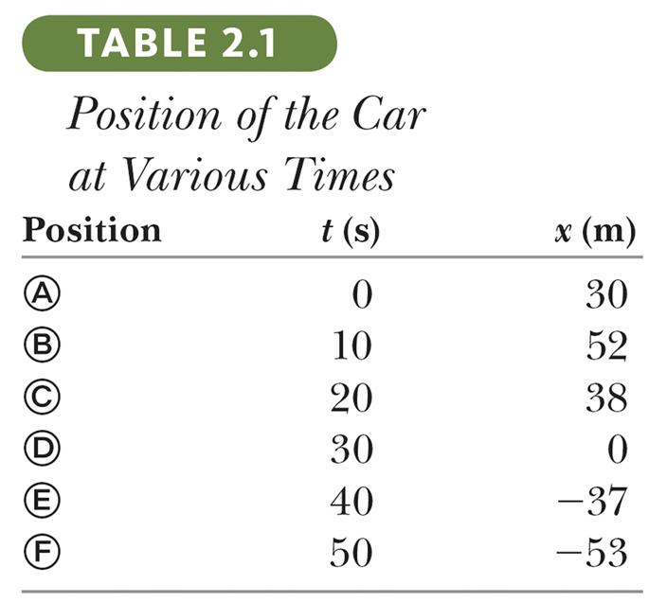
Tabular Representation: Data Table
The table gives the actual data collected during the motion of the object (car).
Positive is defined as being to the right
This is another representations of the motion of the car

Slide 11
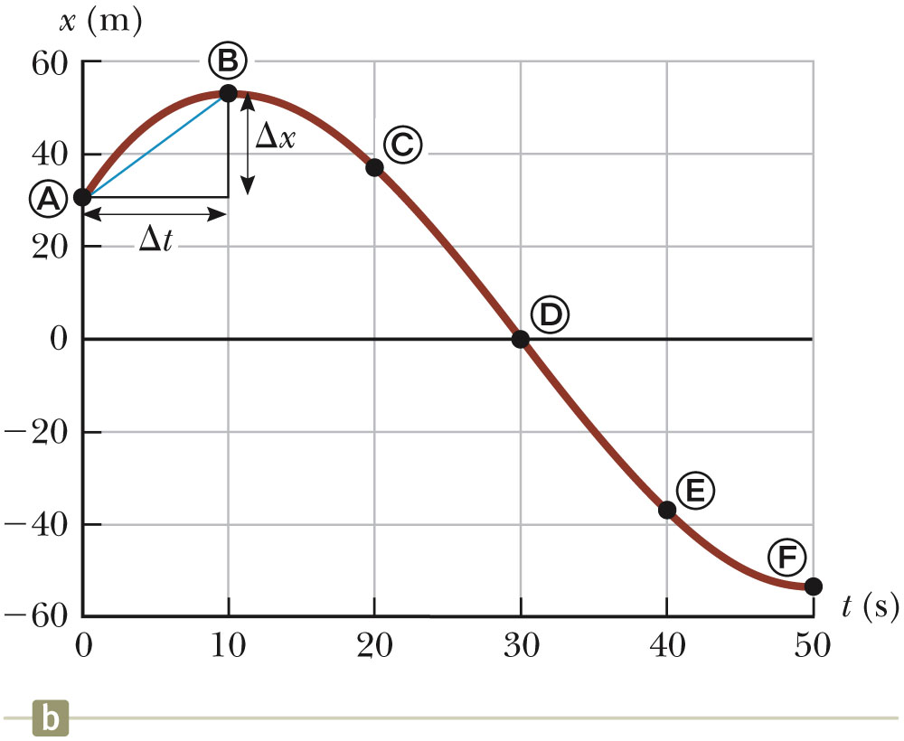
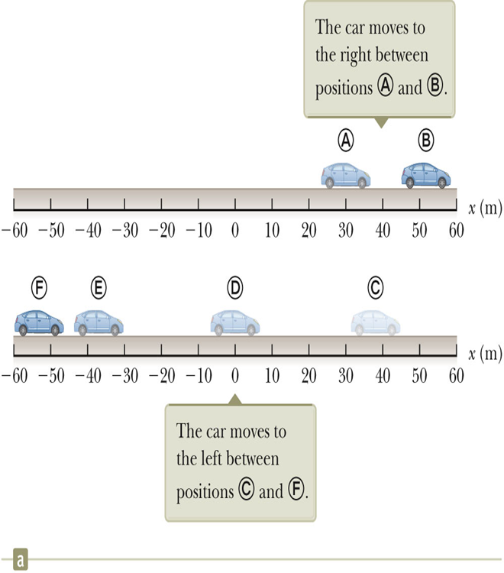
Graphical Representation: Position-Time Graph
The position-time graph shows the motion of the particle (car).
The smooth curve is a guess as to what happened between the data points.
This is one representation of the motion of the car

Slide 12
Displacement and Distance
Displacement is defined as the change in position during some time interval.
  Represented as Δx (pronounced as delta x)
  Δx ≡ x_{final} – x_{initial} = x_{f} - x_{i}
  SI units are meters (m)
  Δx can be positive or negative
Different from distance
  Distance is the length of a path followed by a particle.
  Note: Displacement can also be defined as distance moved in a given direction

Slide 13
Problem
A car is at a position A=20 km from its starting point. One hour later, it is at B = 60 km away. What is the displacement of the car?
Solution:
Δx= x_{B} – x_{A} = (60-20) km = 40 km

Slide 14

Differences Between Distance and Displacement – An Example
Assume a player moves from one end of the court to the other and back.
Distance is twice the length of the court
  Distance is always positive
Here, displacement is zero
  Δx = x_{f} – x_{i} = 0
  since x_{f} = x_{i}

Slide 15
Vectors and Scalars
Vector quantities need both magnitude (size or numerical value) and direction to completely describe them.
  Will use + and – signs to indicate vector directions
Scalar quantities are completely described by magnitude only.

Slide 16
Speed and Velocity
The average speed of a particle is the ratio of the total distance travelled to the total time taken, regardless of direction
Average speed = total distance (d) /total time (t)
Unit: m/s (SI) ; km/h, miles/h
The average speed tells you nothing about the details of the motion of the particle

Slide 17
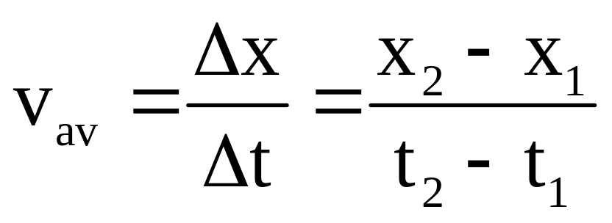
Velocity
The concept of velocity is similar to that of speed but differs because it specifies the direction of the motion
Definition of Velocity: The Average Velocity, v_{av}, of a particle is its displacement, Δx, divided by the time interval, Δt, in which the displacement occurs:

Slide 18
Velocity, cont.
Average velocity has a direction in space.
In one-dimensional problems, v_{av} has a + sign or - sign.
(i) If v_{av} is +, it means the particle moves in the positive x direction
(ii) If v_{av} is -, it means the particle moves in the negative x direction

Slide 19
Average Speed and Average Velocity
Speed is a scalar quantity.
  Has the same units as velocity
  Defined as total distance / total time
The speed has no direction and is always expressed as a positive number.
Neither average velocity nor average speed gives details about the trip described.

Slide 20
Average Speed and Average Velocity
The average speed is not the magnitude of the average velocity.
  For example, if a runner ends at her starting point.
  Her displacement is zero.
  Therefore, her velocity is zero.
  However, the distance traveled is not zero, so the speed is not zero.

Slide 21
Instantaneous Velocity
Suppose a particle moves with constant velocity, then at all times its velocity, v = v_{av} , average velocity
What happens if the particle moves with a velocity that varies with time?
—Need to define the velocity of the particle at a single instant
The instantaneous velocity indicates what is happening at every point of time

Slide 22
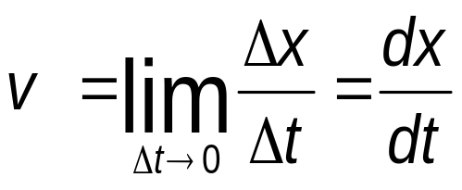
Instantaneous Velocity
Instantaneous Velocity is defined as the limit of the average velocity as the time interval becomes infinitesimally short, or as the time interval approaches zero.
That is, make Δt smaller and smaller

Slide 23
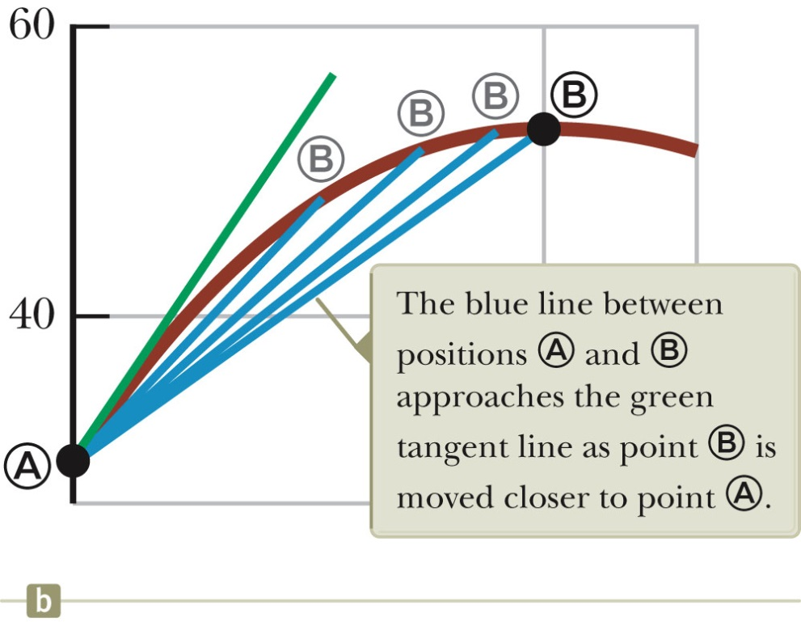
Graphical Representation of Instantaneous Velocity
The instantaneous velocity is the slope of the line tangent to the x vs. t curve.
  This would be the green line.
The blue lines show that as Δt gets smaller, they approach the green line.
In other words, as Δt gets smaller and smaller, we get a “truer” value of the velocity at a particular point

Slide 24
Instantaneous Velocity, cont.
The instantaneous velocity can be positive, negative, or zero

Slide 25
Vocabulary Note
“Velocity” and “speed” will indicate instantaneous values.
Average will be used when the average velocity or average speed is indicated.

Slide 26
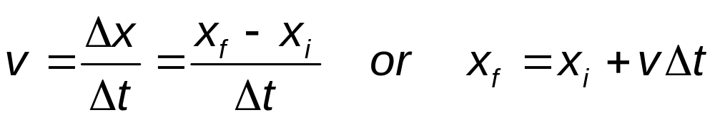
A Particle Under Constant Velocity
Constant velocity indicates the instantaneous velocity at any instant during a time interval and is the same as the average velocity during that time interval.
  v = v_{avg}
  The mathematical representation of this situation is the equation.
  Common practice is to let t_{i} = 0 and the equation becomes:
  x_{f} = x_{i} + vt (for constant v)

Slide 27
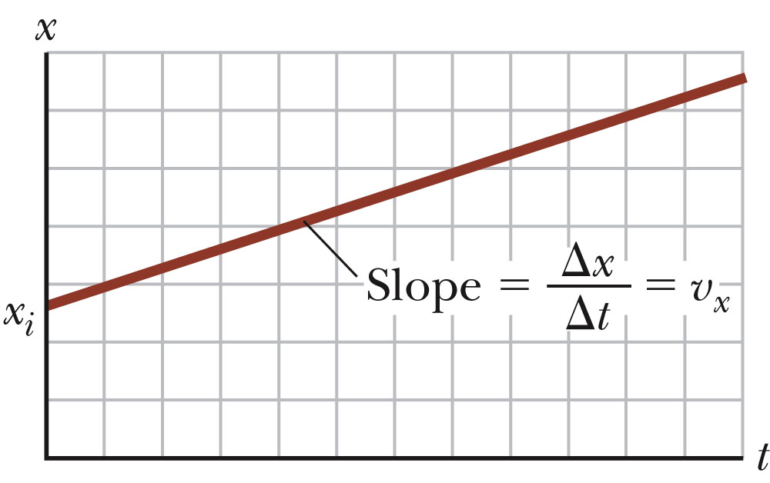
Graph of Particle Under Constant Velocity
The graph represents the motion of a particle under constant velocity.
The slope of the graph is the value of the constant velocity.
The y-intercept is x_{i.}

Slide 28
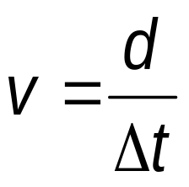
A Particle Under Constant Speed
A particle under constant velocity moves with a constant speed along a straight line.
A particle can also move with a constant speed along a curved path.
This can be represented with a model of a particle under constant speed.
The primary equation is the same as for average speed, with the average speed replaced by the constant speed.

Slide 29
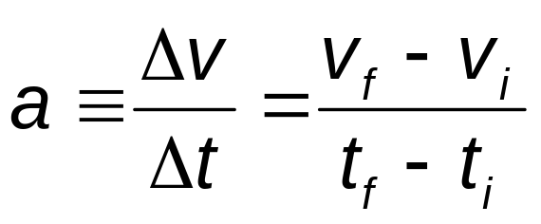
Average Acceleration
Acceleration is the rate of change of the velocity.
Dimensions are L/T²
SI units are m/s²
In one dimension, positive and negative can be used to indicate direction.

Slide 30
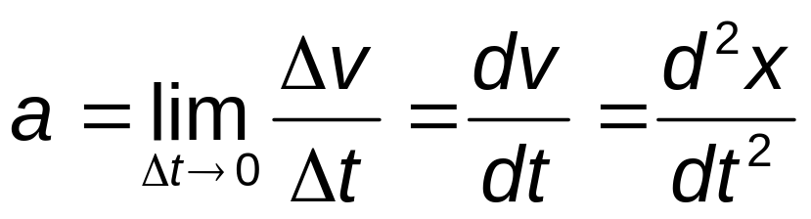
Instantaneous Acceleration
The instantaneous acceleration is the limit of the average acceleration as Δt approaches 0.
The term acceleration will mean instantaneous acceleration.
  If average acceleration is wanted, the word average will be included.

Slide 31
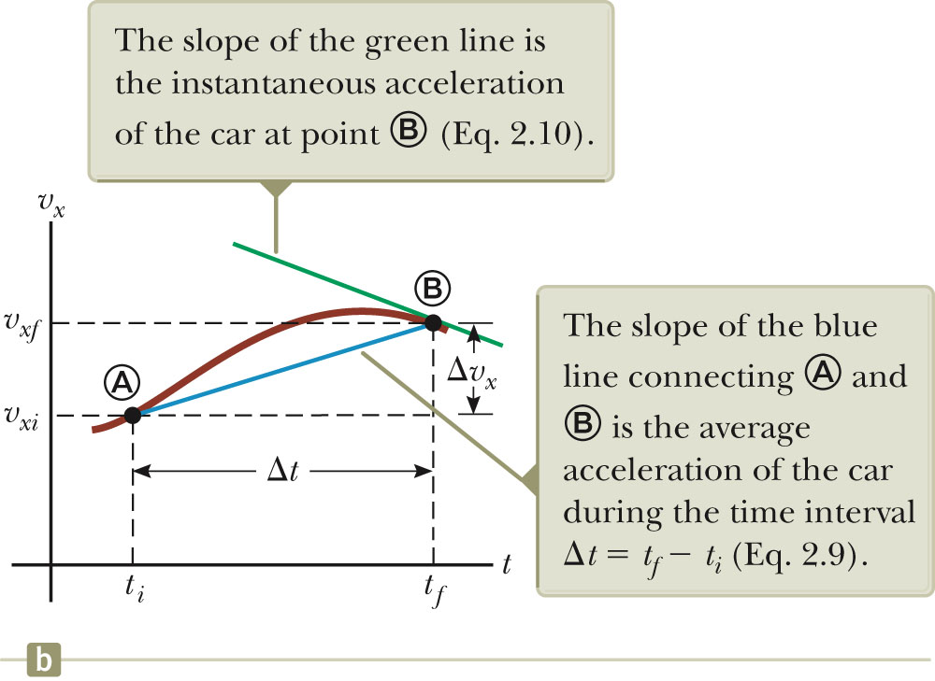
Graph of Instantaneous Acceleration
The slope of the velocity-time graph is the acceleration.
The green line represents the instantaneous acceleration.
The blue line is the average acceleration.

Slide 32
Acceleration and Velocity, Directions
When an object’s velocity and acceleration are in the same direction, the object is speeding up.
When an object’s velocity and acceleration are in the opposite direction, the object is slowing down.

Slide 33
Announcements
Quiz 1
Thursday, October ?? @ CELT 11 or 8
TIME: 6:30 AM or 4:00 PM PROMPT
2. Additional Lecture Hour:
3. Tutorials: Saturdays @ 2:30 PM

Slide 34
Acceleration and Force
The acceleration of an object is related to the total force exerted on the object.
  The force is proportional to the acceleration,
  F_{x} ∝ a .
  Assume the velocity and acceleration are in the same direction.
    The force is in the same direction as the velocity and the object speeds up.
  Assume the velocity and acceleration are in opposite directions.
    The force is in the opposite direction as the velocity and the object slows down.

Slide 35
Kinematic Equations
The kinematic equations can be used with any particle under uniform acceleration.
The kinematic equations may be used to solve any problem involving one-dimensional motion with a constant acceleration.
You may need to use two of the equations to solve one problem.
Many times there is more than one way to solve a problem

Slide 36
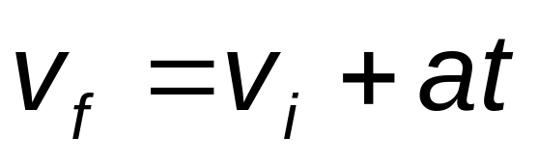
Kinematic Equations, 1
For constant a,
Can determine an object’s velocity at any time t when we know its initial velocity and its acceleration
  Assumes t_{i} = 0 and t_{f} = t
Does not give any information about displacement

Slide 37
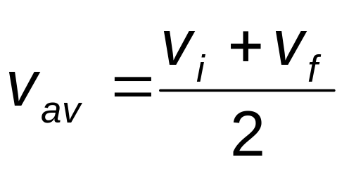
Kinematic Equations, 2
For a body moving at a constant acceleration,
The average velocity can be expressed as the arithmetic mean of the initial and final velocities.
  This applies only in situations where the acceleration is constant.

Slide 38
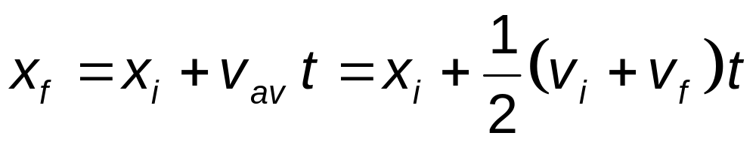
Kinematic Equations, 3
For constant acceleration,
This gives you the position of the particle in terms of time and velocities.
Doesn’t give you the acceleration

Slide 39
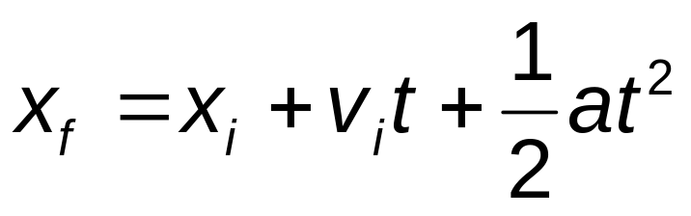
Kinematic Equations, 4
For constant acceleration,
Gives final position in terms of velocity and acceleration
Doesn’t tell you about final velocity

Slide 40
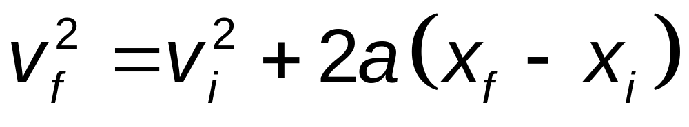
Kinematic Equations, 5
For constant a,
Gives final velocity in terms of acceleration and displacement
Does not give any information about the time

Slide 41
Special Case: When a = 0
When the acceleration is zero,
  v_{f} = v_{i} = v
  x_{f} = x_{i} + vt
The constant acceleration model reduces to the constant velocity model.

Slide 42
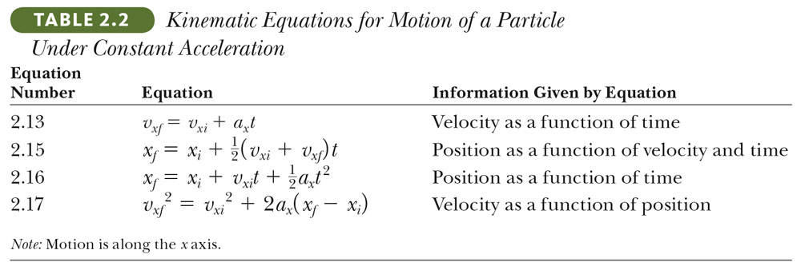
Kinematic Equations – summary

Slide 43
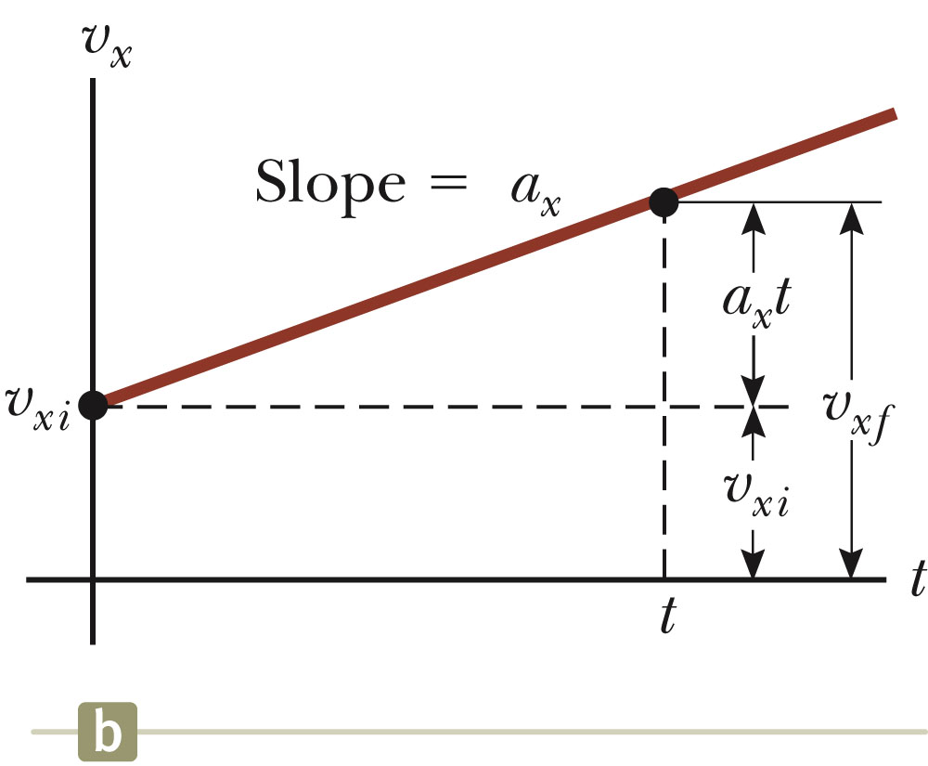
Graphical Look at Motion: Velocity – Time curve
The slope gives
the acceleration.
The straight line
indicates a constant
acceleration.

Slide 44
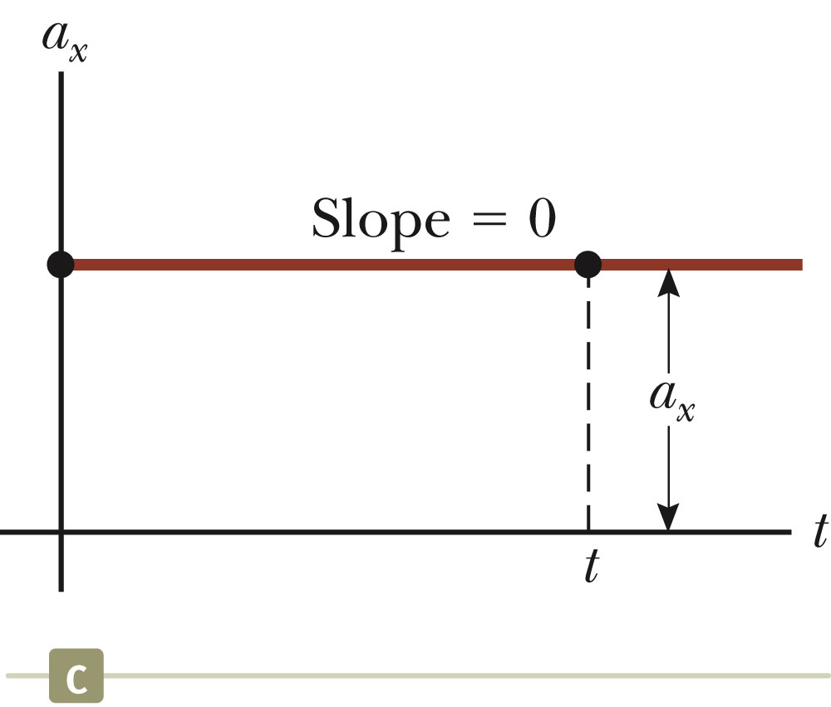
Graphical Look at Motion: Acceleration – Time curve
The zero slope indicates a constant acceleration.

Slide 45
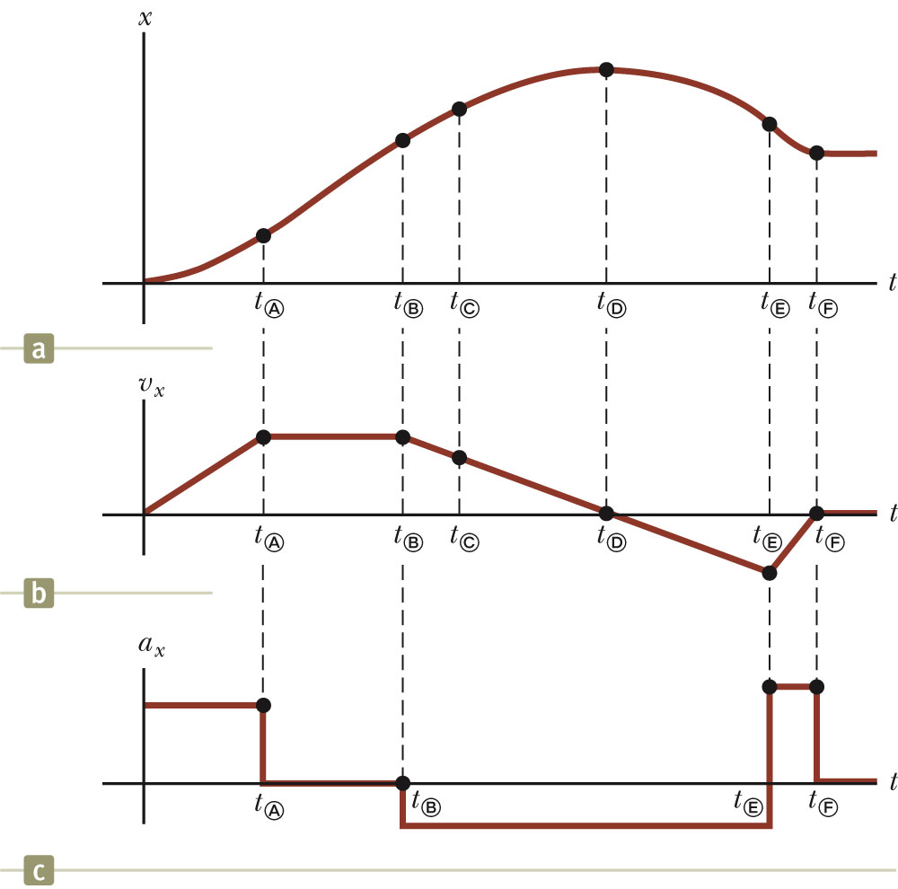
Graphical Comparison
Given the displacement-time graph (a)
The velocity-time graph is found by measuring the slope of the position-time graph at every instant.
The acceleration-time graph is found by measuring the slope of the velocity-time graph at every instant.

Slide 46
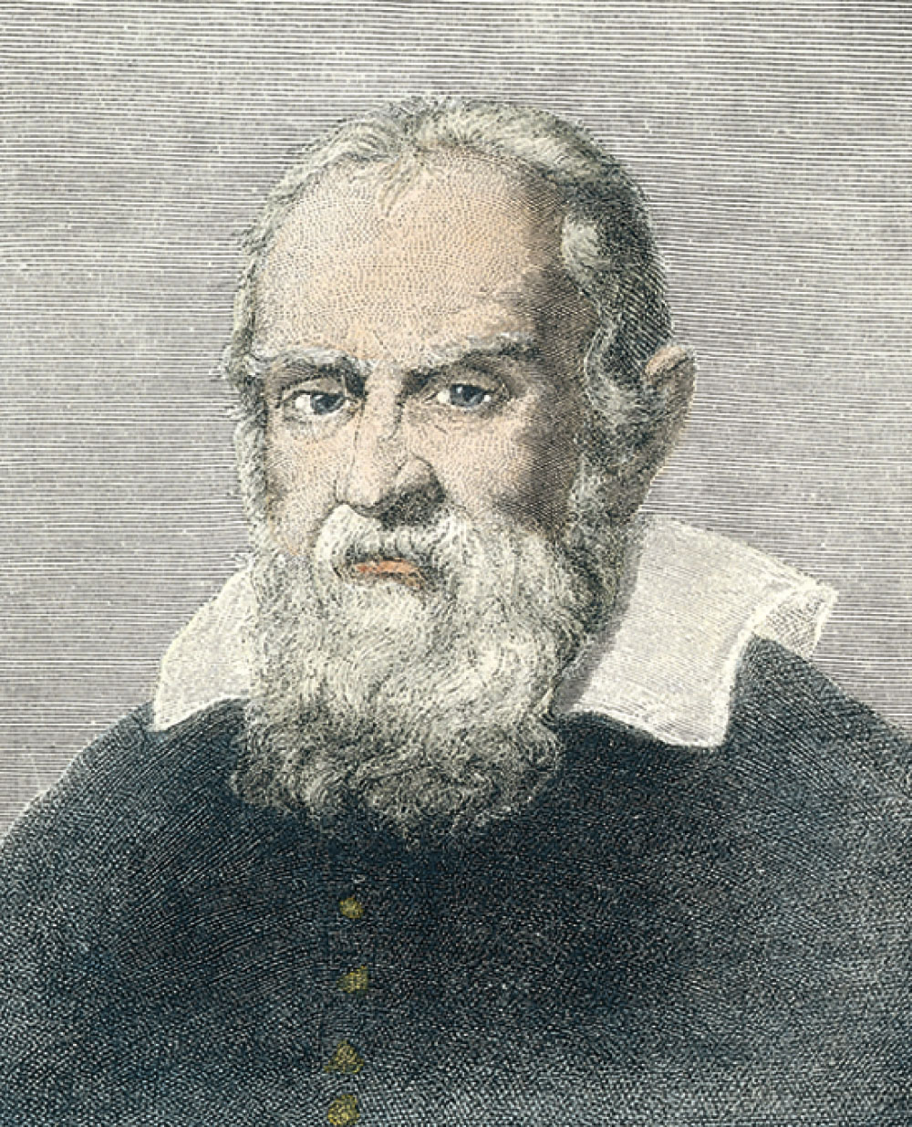
Galileo Galilei
1564 – 1642
Italian physicist and astronomer
Formulated laws of motion for objects in free fall

Slide 47
Freely Falling Objects
A freely falling object is any object moving freely under the influence of gravity alone.
It does not depend upon the initial motion of the object.
  Dropped – released from rest
  Thrown downward
  Thrown upward

Slide 48
Acceleration of Freely Falling Object
The acceleration of an object in free fall is directed downward, regardless of the initial motion.
The magnitude of free fall acceleration is g = 9.80 m/s².
  g decreases with increasing altitude
  g varies with latitude
  9.80 m/s² is the average at the Earth’s surface
  Don’t confuse g with g for grams

Slide 49
Acceleration of Free Fall, cont.
We will neglect air resistance.
Free fall motion is constantly accelerated motion in one dimension.
If you choose upward to be positive
Use the kinematic equations
  With a = -g = -9.80 m/s²
  Note displacement is in the vertical direction

Slide 50
Free Fall – An Object Dropped
Initial velocity is zero
Let up be positive
Use the kinematic equations
  Generally use y instead of x since motion is vertical
Acceleration is
  a=a_{y} = -g = -9.80 m/s²
v_{o}= v_{i} = 0
a = -g

Slide 51
Free Fall – An Object Thrown Downward
a = a_{y} = g = 9.80 m/s²
Initial velocity ≠ 0
  With upward being positive, initial velocity will be negative.
V_{o} ≠ 0
a = g

Slide 52
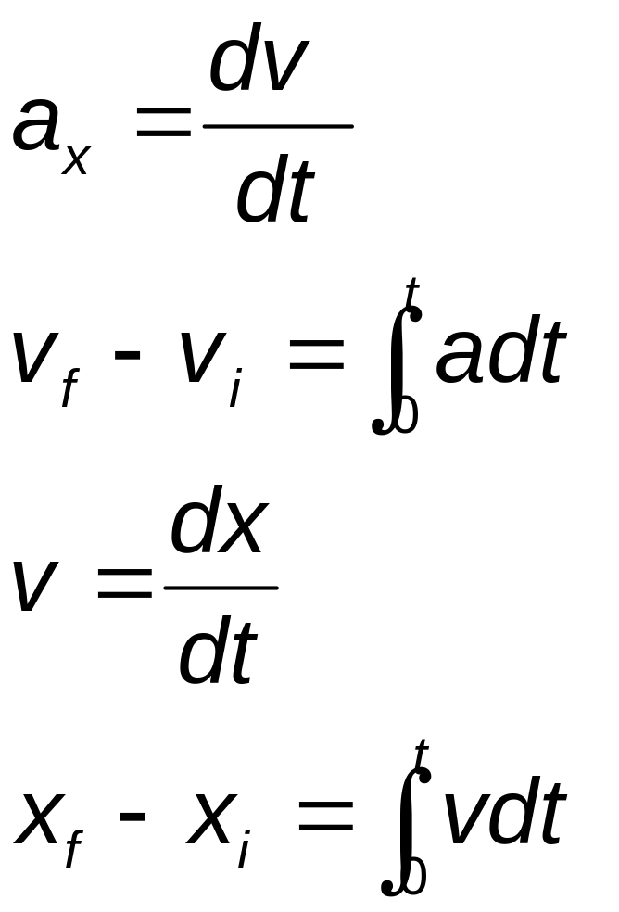
Kinematic Equations – General Calculus Form

Slide 53
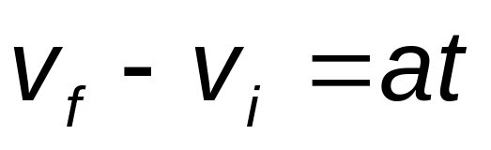
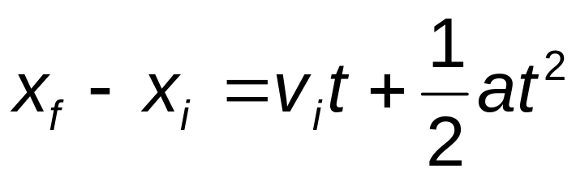
Kinematic Equations – From Integration
The integration form of v_{f} – v_{i} gives
The integration form of x_{f} – x_{i} gives

Slide 54
General Problem Solving Strategy
In addition to basic physics concepts, a valuable skill is the ability to solve complicated problems.
Steps in a general problem solving approach:
  Conceptualize
  Categorize
  Analyze
  Finalize

Slide 55
Problem Solving – Conceptualize
Think about and understand the situation.
Make a quick drawing of the situation.
Gather the numerical information.
  Include algebraic meanings of phrases.
Focus on the expected result.
  Think about units.
Think about what a reasonable answer should be.

Slide 56
Problem Solving – Categorize
Simplify the problem.
  Can you ignore air resistance?
  Model objects as particles
Classify the type of problem.
  Substitution
  Analysis
Try to identify similar problems you have already solved.
  What analysis model would be useful?

Slide 57
Problem Solving – Analyze
Select the relevant equation(s) to apply.
Solve for the unknown variable.
Substitute appropriate numbers.
Calculate the results.
  Include units
Round the result to the appropriate number of significant figures.

Slide 58
Problem Solving – Finalize
Check your result.
  Does it have the correct units?
  Does it agree with your conceptualized ideas?
Look at limiting situations to be sure the results are reasonable.
Compare the result with those of similar problems.

Slide 59
Problem Solving – Some Final Ideas
When solving complex problems, you may need to identify sub-problems and apply the problem-solving strategy to each sub-part.
These steps can be a guide for solving problems in this course.

Slide 60
Problem 1
The position of a particle moving along the x axis is given by x = (21 + 22t - 6.0t²)m, where t is in s. What is the average velocity during the time interval t = 1.0 s to t = 3.0 s?
Ans: -2m/s

Slide 61
Problem 2
A bullet is fired through a board, 14.0 cm thick, with its line of motion perpendicular to the face of the board. If it enters with a speed of 450 m/s and emerges with a speed of 220 m/s, what is the bullet's acceleration as it passes through the board?
Ans: -5.50 x 10⁵m/s²

Slide 62
Problem 3
A particle moving along the x axis has a position given by x = (24t – 2.0t³) m, where t is measured in s. What is the magnitude of the acceleration of the particle at the instant when its velocity is zero?
Ans: 24 m/s

Slide 63
Problem 4
An automobile moving along a straight track changes its velocity from 40 m/s to 80 m/s in a distance of 200 m. What is the (constant) acceleration of the vehicle during this time?

Slide 64
Problem 5
An automobile moving along a straight track changes its velocity from 40 m/s to 80 m/s in a distance of 200 m. What is the (constant) acceleration of the vehicle during this time?
Ans: 12 m/s

